Slide 1
Object Oriented Programming
By – Ashish Kumar

Slide 2
Programming Models
You need to use some programming model to develop any application
Basic purpose of any programming model:
To make the process of writing the complex program less harder
Bug free
Easily understandable
Easily modifiable
Two main programming model:
Procedure oriented programming
Object Oriented Programming

Slide 3
Procedure Oriented Programming
Functions are the main building block of POP
Applications will be divided into multiple functions
All the functions will be defined globally
Problems:
There is no owner for the data so it is very difficult to main the data integrity
Any function can use any data
It’s difficult to identify the function which is wrongly using the data.

Slide 4
Object Oriented Programming
Objects are the main building block of OOPS
Your applications will be divided into multiple objects
In OOP, all the data and methods will be encapsulated into a class.
Everything in the world is an Object

Slide 5
Continue..
An object has state, behavior
State and behavior of an object can be defined in a class
Class stack{
$top;
$name;
push();
pop();
}
State or Data members or Field or Properties
Behavior or Member functions or Methods

Slide 6
OOPS Concept
There are four major Object Oriented Principles
Abstraction
Encapsulation
Inheritance
Polymorphism

Slide 7
Abstraction
Abstraction is the process of providing necessary properties and operations of an object.
Ex: Mobile
Customer Prospective
Engineer Prospective (Hardware, Software)

Slide 8
Encapsulation
Binding object state(fields) and behavior (methods) together.
Encapsulation is a process of describing the state and behavior of an object in a class.

Slide 9
Inheritance
Inheritance is the process of writing new class by inheriting commonly used state and behavior of existing class
Person{
Age, name
Walk();
Eat();
}
Student{
Sid, fee
Read();
Sleep();
}
Employee{
eid, salary,
work();
}

Slide 10
Polymorphism
Polymorphism (One name – Many forms)
Polymorphism is the ability of an object to behave differently at different situations.

Slide 11
Classes and Objects
A class is an expended concept of a structure i.e. instead of holding only data
Class can hold both data and functions
Class contains logical description of real world entity in terms of state and behavior
Class = State + Behavior
Class is a prototype or template or pattern or blueprint of object’s state and behavior.

Slide 12
OOPS Course
Properties
Class Constants
Autoloading Classes
Constructors and Destructors
Visibility
Object Inheritance
Scope Resolution Operator (::)
Static Keyword
Class Abstraction
Object Interfaces
Traits
Anonymous classes
Overloading
Object Iteration
Magic Methods
Final Keyword
Object Cloning
Comparing Objects
Type Hinting
Late Static Bindings
Objects and references
Object Serialization

Slide 13
Lab
Creating a Simple Class
Creating an object (Demo on Person class)
Creating properties
Creating Constants
Accessing Constant (Scope Resolution Operator)
Creating Methods
$this (Pseudo-variable)
Constructor
Initial parameter Passing
Inheritance
Protected Properties
Private Properties
Static Properties & Methods
Scope Resolution Operator
Self

Slide 14
$this
The pseudo-variable $this is available when a method is called from within an object context.
$this is a reference to the calling object

Slide 15
new
To create an instance of a class, the new keyword must be used.
An object will always be created unless the object has a constructor defined that throws an exception on error.
Classes should be defined before instantiation
If a string containing the name of a class is used with new, a new instance of that class will be created.
If the class is in a namespace, its fully qualified name must be used when doing this.

Slide 16
Properties
Class member variables are called "properties". You may also see them referred to using other terms such as "attributes" or "fields", but for the purposes of this reference we will use "properties".
They are defined by using one of the keywords public, protected, or private, followed by a normal variable declaration.
This declaration may include an initialization, but this initialization must be a constant value--that is, it must be able to be evaluated at compile time and must not depend on run-time information in order to be evaluated.

Slide 17
Properties and methods
Class properties and methods live in separate "namespaces", so it is possible to have a property and a method with the same name.
Referring to both a property and a method has the same notation, and whether a property will be accessed or a method will be called, solely depends on the context, i.e. whether the usage is a variable access or a function call.

Slide 18
Visibility
The visibility of a property, a method or (as of PHP 7.1.0) a constant can be defined by prefixing the declaration with the keywords
public, protected or private.
Class members declared public can be accessed everywhere.
Members declared protected can be accessed only within the class itself and by inheriting and parent classes.
Members declared as private may only be accessed by the class that defines the member.

Slide 19
Extends
A class can inherit the methods and properties of another class by using the keyword extends in the class declaration.
It is not possible to extend multiple classes; a class can only inherit from one base class.
The inherited methods and properties can be overridden by re-declaring them with the same name defined in the parent class.
However, if the parent class has defined a method as final, that method may not be overridden. It is possible to access the overridden methods or static properties by referencing them with parent::.
When overriding methods, the parameter signature should remain the same or PHP will generate an E_STRICT level error. This does not apply to the constructor, which allows overriding with different parameters.

Slide 20
Final
PHP 5 introduces the final keyword, which prevents child classes from overriding a method by prefixing the definition with final. If the class itself is being defined final then it cannot be extended.

Slide 21
Static
The static keyword that the variable or function is shared between all instances of that class as it belongs to the type, not the actual objects themselves.
Declaring class properties or methods as static makes them accessible without needing an instantiation of the class.
A property declared as static cannot be accessed with an instantiated class object (though a static method can).
Because static methods are callable without an instance of the object created, the pseudo-variable $this is not available inside the method declared as static.
In PHP 7, calling non-static methods statically is deprecated, and will generate an E_DEPRECATED warning.

Slide 22
Autoloading Classes
In PHP 5, the spl_autoload_register() function registers any number of autoloaders, enabling for classes and interfaces to be automatically loaded if they are currently not defined
By registering autoloaders, PHP is given a last chance to load the class or interface before it fails with an error.
Although the __autoload() function can also be used for autoloading classes and interfaces, it's preferred to use the spl_autoload_register() function.
exceptions thrown in the __autoload() function could not be caught in the catch block and would result in a fatal error.

Slide 23
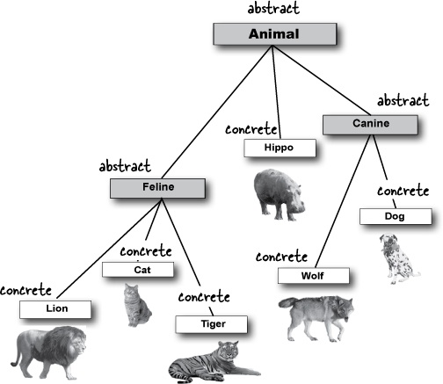
Abstraction

Slide 24
Abstraction
Is used to hide certain details and only show the essential features of the object.
PHP 5 introduces abstract classes and methods.
Classes defined as abstract may not be instantiated, and any class that contains at least one abstract method must also be abstract.
Methods defined as abstract simply declare the method's signature - they cannot define the implementation.
When inheriting from an abstract class, all methods marked abstract in the parent's class declaration must be defined by the child;
additionally, these methods must be defined with the same (or a less restricted) visibility.
For example, if the abstract method is defined as protected, the function implementation must be defined as either protected or public, but not private.
Furthermore the signatures of the methods must match
Notes:
Abstract - existing in thought or as an idea but not having a physical or concrete existence

Slide 25
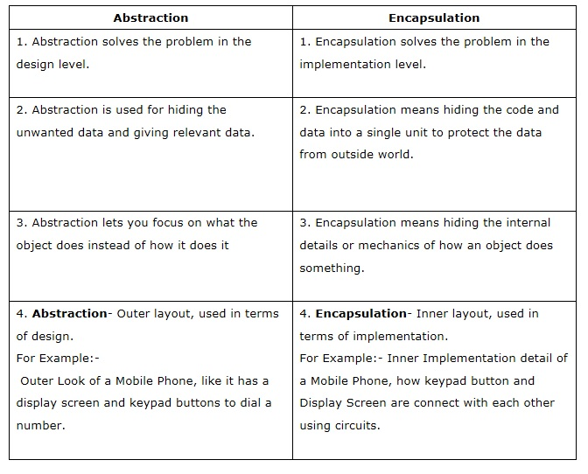
Abstraction Vs. Encapsulation

Slide 26
Interface
Interface is a special class which is fully abstracted
When you write sub class of an interface then:
Subclass has to implement all of the methods of implemented interface
When subclass is not implementing one or more methods of interface then subclass must be declared as abstract
You can’t instantiate interface i.e. object of interface can’t be created.
Interfaces are defined in the same way as a class, but with the interface keyword replacing the class keyword and without any of the methods having their contents defined.
All methods declared in an interface must be public; this is the nature of an interface.
Note that it is possible to declare a constructor in an interface, what can be useful in some contexts, e.g. for use by factories.

Slide 27
Implements
To implement an interface, the implements operator is used.
All methods in the interface must be implemented within a class; failure to do so will result in a fatal error.
Classes may implement more than one interface if desired by separating each interface with a comma.
Prior to PHP 5.3.9, a class could not implement two interfaces that specified a method with the same name, since it would cause ambiguity. More recent versions of PHP allow this as long as the duplicate methods have the same signature.

Slide 28
Traits
As of PHP 5.4.0, PHP implements a method of code reuse called Traits.
Traits are a mechanism for code reuse in single inheritance languages such as PHP.
A Trait is intended to reduce some limitations of single inheritance.
The semantics of the combination of Traits and classes is defined in a way which reduces complexity, and avoids the typical problems associated with multiple inheritance.
A Trait is similar to a class.
It is not possible to instantiate a Trait on its own.
It is an addition to traditional inheritance and enables horizontal composition of behavior; that is, the application of class members without requiring inheritance.

Slide 29
If a trait defines a property then a class can not define a property with the same name unless it is compatible (same visibility and initial value), otherwise a fatal error is issued.
Before PHP 7.0.0, defining a property in the class with the same visibility and initial value as in the trait, raised an E_STRICT notice.
Using the as syntax, one can also adjust the visibility of the method in the exhibiting class.
Traits Composed from Traits
Traits support the use of abstract methods in order to impose requirements upon the exhibiting class
Traits can define both static members and static methods.

Slide 30
Precedence: Child Class-> Traits-> Parents Class
Multiple Traits can be inserted into a class by listing them in the use statement, separated by commas.
If two Traits insert a method with the same name, a fatal error is produced, if the conflict is not explicitly resolved.
To resolve naming conflicts between Traits used in the same class, the insteadof operator needs to be used to choose exactly one of the conflicting methods.
Since this only allows one to exclude methods, the as operator can be used to add an alias to one of the methods. Note the as operator does not rename the method and it does not affect any other method either.

Slide 31
Namespaces
Namespaces are a way of encapsulating items.
In the PHP world, namespaces are designed to solve two problems when creating re-usable code elements such as classes or functions:
Name collisions
(between code you create, and internal PHP classes/functions/constants or third-party classes/functions/constants.)
Ability to alias (or shorten)
(Extra_Long_Names designed to reduce the first problem, improving readability of source code.)
PHP Namespaces provide a way in which to group related classes, interfaces, functions and constants.
Namespace names PHP and php, and compound names starting with these names (like PHP\Classes) are reserved for internal language use and should not be used in the userspace code.

Slide 32
Code are affected by namespaces: classes (including abstracts and traits), interfaces, functions and constants.
Namespaces are declared using the namespace keyword.
A file containing a namespace must declare the namespace at the top of the file before any other code - with one exception: the declare keyword.
Declaring sub-namespaces:
Much like directories and files, PHP namespaces also contain the ability to specify a hierarchy of namespace names.
Using Namespaces by Use keyword.

Slide 33
Functions
User-defined functions
Function arguments
Returning values
Variable functions
Internal (built-in) functions
Anonymous functions

Slide 34
User Defined Function
Any valid PHP code may appear inside a function, even other functions and class definitions.
A valid function name starts with a letter or underscore, followed by any number of letters, numbers, or underscores.
As a regular expression, it would be expressed thus: [a-zA-Z_\x7f-\xff][a-zA-Z0-9_\x7f-\xff]*.
Functions need not be defined before they are referenced, except when a function is conditionally defined.
When a function is defined in a conditional manner, its definition must be processed prior to being called.
All functions and classes in PHP have the global scope - they can be called outside a function even if they were defined inside and vice versa.
PHP does not support function overloading.
Note: Function names are case-insensitive, though it is usually good form to call functions as they appear in their declaration.
It is possible to call recursive functions in PHP.
Notes:
Unicode Hex Character

Slide 35
Recursion
Recursion is the process of calling one method from itself
Recursive function/method calls with over 100-200 recursion levels can smash the stack and cause a termination of the current script. Especially, infinite recursion is considered a programming error.

Slide 36
Function Arguments
Information may be passed to functions via the argument list, which is a comma-delimited list of expressions. The arguments are evaluated from left to right.
PHP supports passing arguments by value (the default), passing by reference, and default argument values. Variable-length argument lists are also supported.

Slide 37
Passing arguments by value:
By default, function arguments are passed by value
if the value of the argument within the function is changed, it does not get changed outside of the function.
Passing arguments by reference:
To allow a function to modify its arguments and it gets changed outside of the function
To passed by reference, prepend an ampersand (&) to the argument name in the function definition

Slide 38
Type declarations
Type declarations allow functions to require that parameters are of a certain type at call time.
If the given value is of the incorrect type, then an error is generated: in PHP 5, this will be a recoverable fatal error, while PHP 7 will throw a TypeError exception.
To specify a type declaration, the type name should be added before the parameter name. The declaration can be made to accept NULL values if the default value of the parameter is set to NULL.

Slide 39
Default argument values
The default value must be a constant expression, not (for example) a variable, a class member or a function call.
Note that when using default arguments, any defaults should be on the right side of any non-default arguments; otherwise, things will not work as expected.

Slide 40
Valid type
Type | Description | Minimum PHP version
Class/interface name | The parameter must be an instanceof the given class or interface name. | PHP 5.0.0
self | The parameter must be an instanceof the same class as the one the method is defined on. This can only be used on class and instance methods. | PHP 5.0.0
array | The parameter must be an array. | PHP 5.1.0
callable | The parameter must be a valid callable. | PHP 5.4.0
bool | The parameter must be a boolean value. | PHP 7.0.0
float | The parameter must be a floating point number. | PHP 7.0.0
int | The parameter must be an integer. | PHP 7.0.0
string | The parameter must be a string. | PHP 7.0.0
iterable | The parameter must be either an array or an instanceof Traversable. | PHP 7.1.0

Slide 41
Strict typing
By default, PHP will force values of the wrong type into the expected scalar type if possible.
For example, a function that is given an integer for a parameter that expects a string will get a variable of type string.
It is possible to enable strict mode on a per-file basis. In strict mode, only a variable of exact type of the type declaration will be accepted, or a TypeError will be thrown.
The only exception to this rule is that an integer may be given to a function expecting a float.
Function calls from within internal functions will not be affected by the strict_types declaration.
To enable strict mode, the declare statement is used with the strict_types declaration

Slide 42
Variable-length argument lists
PHP has support for variable-length argument lists in user-defined functions. This is implemented using the ... token in PHP 5.6 and later, and using the func_num_args(), func_get_arg(), and func_get_args() functions in PHP 5.5 and earlier.
In PHP 5.6 and later, argument lists may include the ... token to denote that the function accepts a variable number of arguments. The arguments will be passed into the given variable as an array;

Slide 43
Variable Function
PHP supports the concept of variable functions.
This means that if a variable name has parentheses appended to it, PHP will look for a function with the same name as whatever the variable evaluates to, and will attempt to execute it.
Among other things, this can be used to implement callbacks, function tables, and so forth.
Variable functions won't work with language constructs such as echo, print, unset(), isset(), empty(), include, require and the like.
Utilize wrapper functions to make use of any of these constructs as variable functions.

Slide 44
Anonymous functions
Anonymous functions, also known as closures, allow the creation of functions which have no specified name.
They are most useful as the value of callback parameters, but they have many other uses.
Closures can also be used as the values of variables; PHP automatically converts such expressions into instances of the Closure internal class.
Assigning a closure to a variable uses the same syntax as any other assignment, including the trailing semicolon:
Closures may also inherit variables from the parent scope.
Any such variables must be passed to the use language construct.
From PHP 7.1, these variables must not include superglobals, $this, or variables with the same name as a parameter.
Inheriting variables from the parent scope is not the same as using global variables. Global variables exist in the global scope, which is the same no matter what function is executing.
The parent scope of a closure is the function in which the closure was declared (not necessarily the function it was called from).

Slide 45
As of PHP 5.4.0, when declared in the context of a class, the current class is automatically bound to it, making $this available inside of the function's scope. If this automatic binding of the current class is not wanted, then static anonymous functions may be used instead.
As of PHP 5.4, anonymous functions may be declared statically. This prevents them from having the current class automatically bound to them. Objects may also not be bound to them at runtime.

Slide 46
The Closure class
Class used to represent anonymous functions.
Anonymous functions, implemented in PHP 5.3.
This fact used to be considered an implementation detail, but it can now be relied upon. Starting with PHP 5.4, this class has methods that allow further control of the anonymous function after it has been created.
Besides the methods listed here, this class also has an __invoke method. This is for consistency with other classes that implement calling magic, as this method is not used for calling the function.
Closure {
/* Methods */
private __construct ( void )
public static Closure bind ( Closure $closure , object $newthis [, mixed $newscope = "static" ] )
public Closure bindTo ( object $newthis [, mixed $newscope = "static" ] )
public mixed call ( object $newthis [, mixed $... ] )
public static Closure fromCallable ( callable $callable )
}

